Slide 1
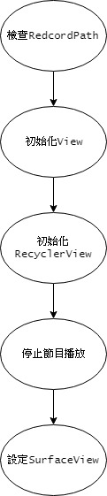
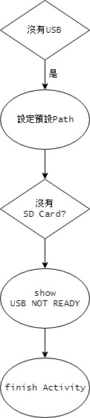
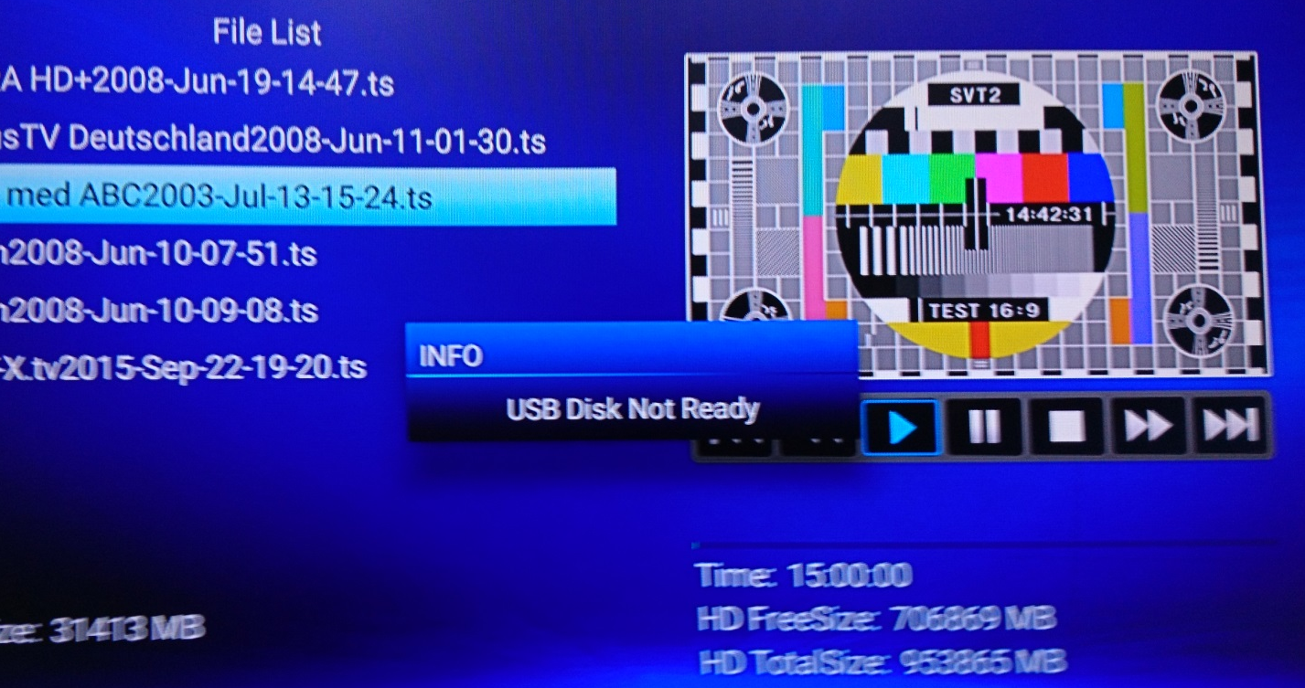
onCreate-1 CheckRecordPath()
選擇path錯誤
yes
預設path錯誤
yes
預設path錯誤
Rec Path not available

Slide 2
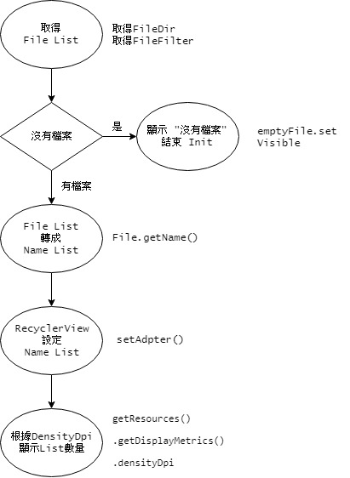
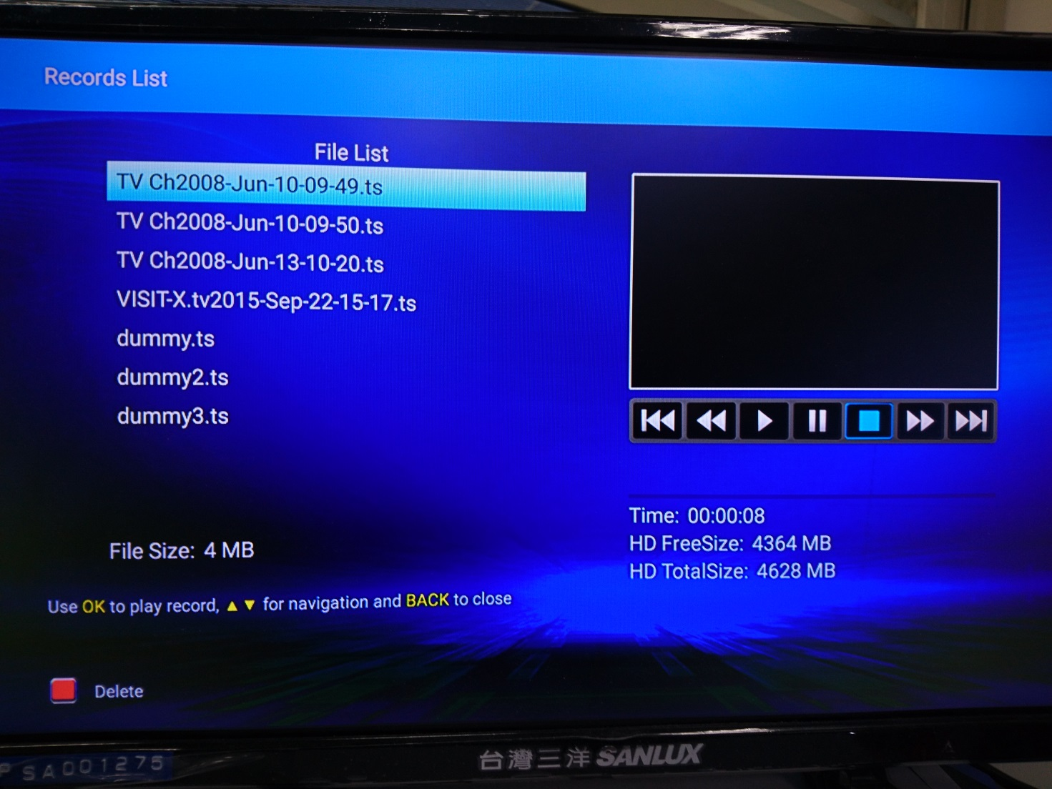
onCreate-2 InitRecList()
InitRecList()

Slide 3
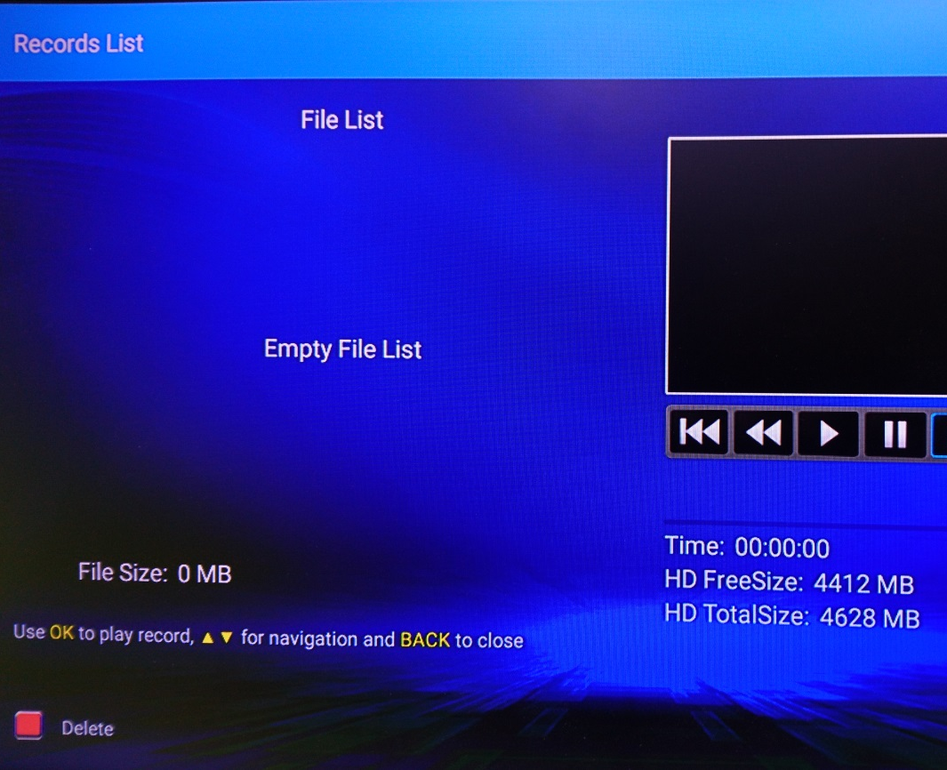
onCreate-3 InitRecList()
InitRecList()

Slide 4
onCreate-4 InitRecList()
InitRcList()

Slide 5
onCreate-5 InitRecList()
272, 320, 372, 426, 480

Slide 6
onCreate-6 AvControl...()
AvControlPlayStop()
AvControlClose()

Slide 7
onCreate-7 setSurface()
setSurface(surfaceView)
PvrPlayStop() // fix全螢幕按home鍵無法關

Slide 8
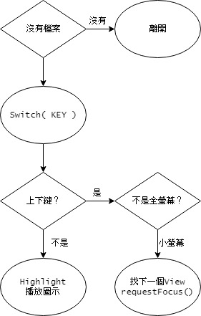
onKeyDown /上下鍵
getChildAdapterPosition 目前位置
上 ( 位置 - 1 )
下 ( 位置 + 1 )
getLayoutManager() .findViewByPosition() 新的View
View.requestFocus()
離開onKeyDown
有
有
Set Play Status

Slide 9
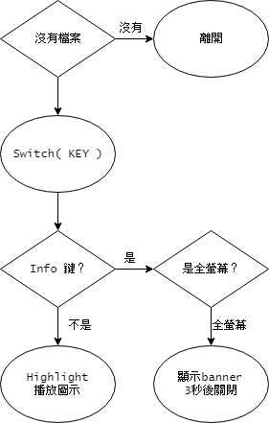

onKeyDown/ INFO鍵
Runnable -> updateProgress -> 更新progress
removeCallback 舊的hideBanner
postDelayed ( 隱藏banner, 3秒後 )
有
有
PostDelayed : hide Banner, 3s

Slide 10
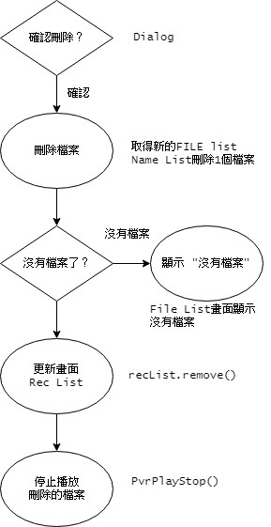
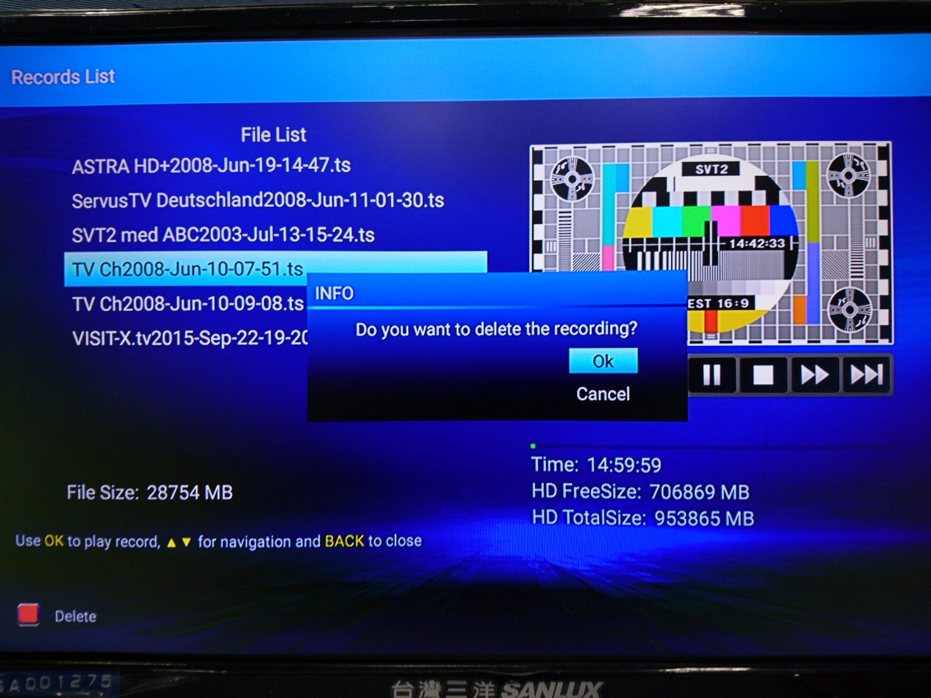
onKeyDown/ 紅鍵-1
yes
no

Slide 11
onKeyDown/ 紅鍵-2
PvrFileRemove
yes
no

Slide 12
onKeyDown/ 紅鍵-3
yes
no

Slide 13
onKeyDown/ 紅鍵-4
yes
no
RecyclerView更新畫面

Slide 14
onKeyDown/ 紅鍵-5
yes
no

Slide 15
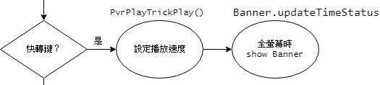

onKeyDown/ 快轉鍵
Runnable:
progress Update

Slide 16
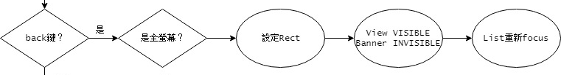
onKeyDown/ Back鍵
Small rect
yes
Item
requestFocus
no
離開
Records List
PVRActivity
ALL VISIBLE

Slide 17
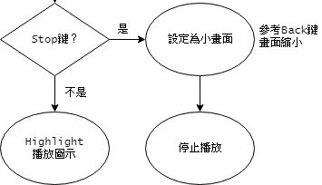
onKeyDown/ stop鍵
同上頁Back鍵
只有PvrPlayStop
PvrPlay”Stop”

Slide 18
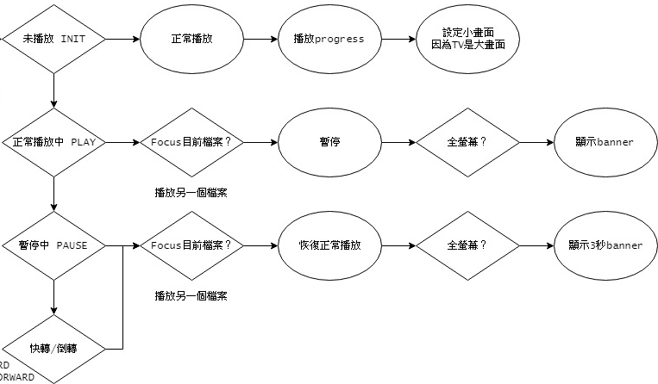
PlayPause鍵-INIT
狀態
PvrPlayStart
INIT
PvrPlay”Start”
Post . updateProgress

Slide 19
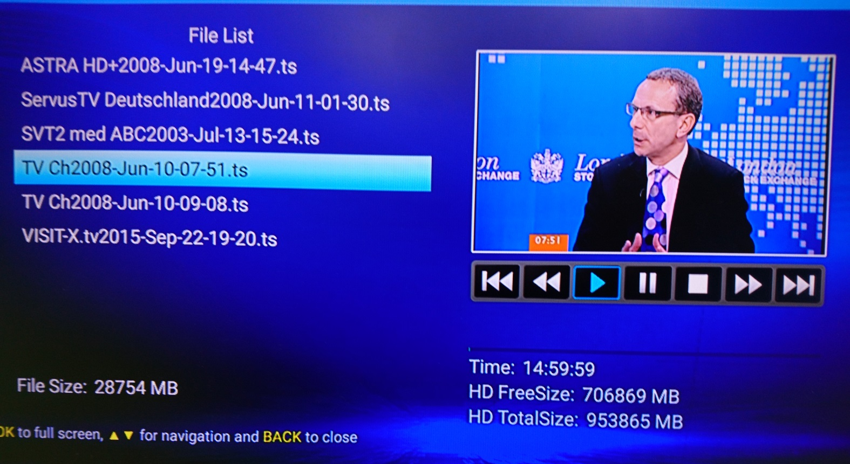
PlayPause鍵-PLAY
狀態
Post banner
另一個
PLAY
focus目前
PvrPlay”Pause”
PvrPlayStart

Slide 20
PlayPause鍵-PAUSE FAST FORWARD / BACK FORWARD
PostDelayed banner
狀態
PAUSE
另一個
focus目前
PvrPlay”Resume”

Slide 21
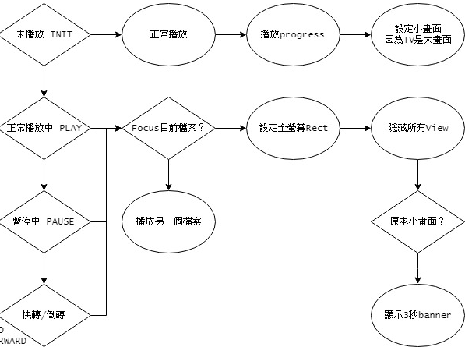
OK鍵-INIT
狀態
同PlayPause鍵
INIT
PvrPlay”Start”
Post . updateProgress

Slide 22
OK鍵-1 PLAY, PAUSE, FORWARD
狀態
PLAY/ PAUSE/ FORWARD/ BACKWARD
另一個
PvrPlay”Start”

Slide 23
OK鍵-2 PLAY, PAUSE, FORWARD
狀態
PLAY/ PAUSE/ FORWARD/ BACKWARD
focus目前

Slide 24
OK鍵-3 PLAY, PAUSE, FORWARD
狀態
PLAY/ PAUSE/ FORWARD/ BACKWARD
focus目前
隱藏
隱藏

Slide 25

OK鍵-4 PLAY, PAUSE, FORWARD
狀態
PLAY/ PAUSE/ FORWARD/ BACKWARD
focus目前
隱藏
隱藏

Slide 26
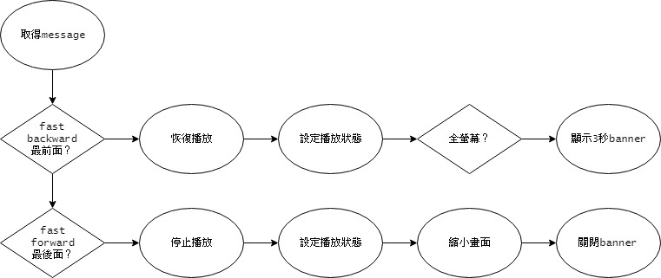
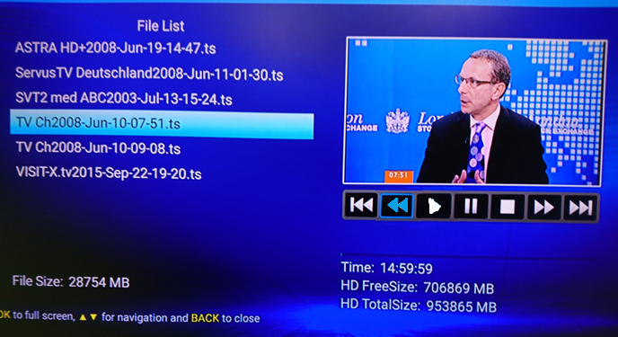
onMessage FAST BACKWARD-1
FAST BACKWARD
PvrPlay”Resume”

Slide 27
onMessage FAST BACKWARD-2
FAST BACKWARD
Set Play Status

Slide 28
onMessage FAST BACKWARD-3
FAST BACKWARD
postDelayed : hide Banner, 3s

Slide 29

onMessage FAST FORWARD-1
FAST FORWARD
PvrPlay”Stop”

Slide 30
onMessage FAST FORWARD-2
FAST FORWARD
Set Play Status

Slide 31
onMessage FAST FORWARD-3
FAST FORWARD
Set Screen

Slide 32
onMessage FAST FORWARD-4
FAST FORWARD
Set INVISIBLE

